Slide 1
Behind The Hype of Hyperconverged
Simplify Virtual Apps and Data
Alex Wilson – Solutions Architect
November 2018
Notes:
We are here today to share how HPE is simplifying hybrid IT with HPE SimpliVity. HPE is the technology and innovation leader in Hyperconverged to solve business challenges and improve business outcomes.
Want to show you the advantages of Hyperconverged and software-defined infrastructure over legacy IT.
+++++
Notes for sales not to be shared directly with customer:
Understand what are the compelling events, Current Pain; What’s Important to customer?
Desire to modernize legacy SimpliVity systems and move to new HPE SimpliVity 380 Gen10
Desire to modernize legacy HC380, HC250 systems and move to new HPE SimpliVity 380 Gen10
Wish to get on supported HPE hardware that is not entering End of Life lifecycle
Wish to be on latest DL380 Gen10 hardware, CPUs, All-Flash offerings

Slide 2

HPE makes Hybrid IT simple with Software-Defined Infrastructure
Simplify virtual apps and data - accelerate app performance, speed business continuity, lower costs and achieve an enterprise cloud in minutes
4.5X
<1
69%
Better application performance than traditional IT
Minute to backup
and restore a 1TB VM -
Guaranteed
Cost savings compared
to traditional IT and up to
55% compared to public cloud
Notes:
Focusing on Hybrid IT, HPE makes Hybrid IT simple…
We leverage our technology and innovation including Hyperconverged infrastructure (HCI) and Software-defined Infrastructure (SDI) to make IT simpler.
Specifically relating to Hyperconverged, which is a very hot segment right now, HPE helps customers in highly virtualized environments to
Simplify virtual apps and data - accelerate app performance,
speed business continuity, lower costs and achieve an enterprise cloud in minutes
HPE is the technology and innovation leader in Hyperconverged to solve business challenges and improve business outcomes.
Examples of improved business outcomes include:
1. 4.5x better application performance over traditional IT (sources: customer examples including Red Bull Racing; see case study what took 9 minutes before now takes 2 minutes on HPE SimpliVity.)
2. Less than 1 minute to backup – OR restore – a 1 TB VM; we back this up with the HPE Hyperguarantee, the industry’s most complete guarantee; Only HCI vendor to offer a guarantee (source: see HPE Hyperguarantee slide and website)
3. HPE SimpliVity yields 69% cost savings compared to traditional IT and delivers up to 55% savings compared to public cloud (AWS)
(sources: Forrest TEI paper and Evaluator Group report)
The next slide builds on this… and shows some of the real outcomes.
Sources:
5x performance video: https://youtu.be/C5IrNz2wWO8
HPE Hyperguarantee: https://h20195.www2.hpe.com/V2/GetDocument.aspx?docname=A00009180ENW
Forrester TEI paper: https://www.hpe.com/us/en/resources/integrated-systems/simplivity-economic-impact.html?parentPage=/us/en/products/integrated-systems/simplivity
Evaluator Group TCO comparison: https://www.simplivity.com/wp-content/uploads/Evaluator-Group-Independent-3-Year-TCO-Comparison-between-SimpliVity-and-AWS-20160119.pdf

Slide 3

HyperConvergence??
vs
Notes:
Script:
We like to think of hyperconvergence as a smart phone. Where you used to have separate devices such as a calculator, an alarm clock, a GPS, a telephone, a music player, and a camera, you now have a smart phone where all of these different applications are combined into one single device. Hyperconvergence is much the same. At SimpliVity, we combine all of the aspects of IT which used to be separate into an easy-to-use, simple device.

Slide 4
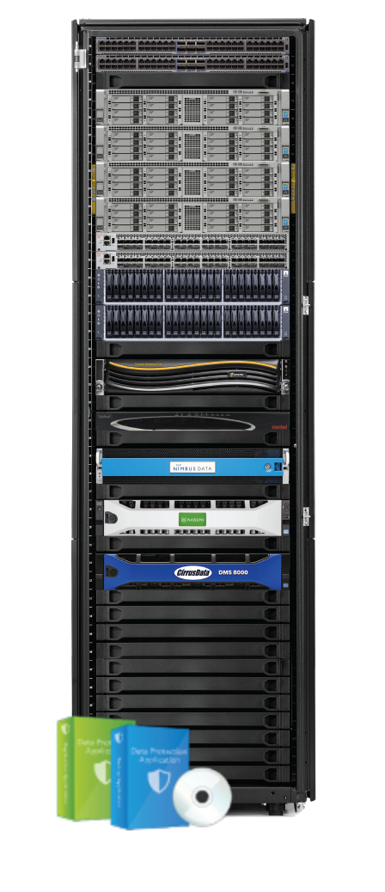
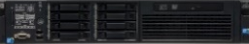
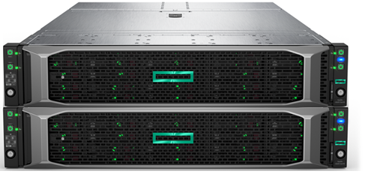
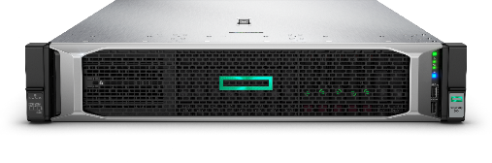

HPE SimpliVity: the powerhouse in hyperconvergence
The industry’s most powerful hyperconverged platform for enterprise, uniting best-in-class data services with All-Flash portfolio
All IT infrastructure and advanced data services in a single building block.
  Global VM-Centric Management and Mobility
  Integrated hypervisor runs core apps on x86 resource pool
  Performance enabled by data locality and inline dedupe, compression
  Built-in Resiliency, Backup, and DR with ability to rapidly recover
  Accelerated Data Efficiency
  Reduced costs compared to legacy IT
  Multi-cloud ready: Build clouds and deploy apps in minutes with a few clicks
Legacy servers and hypervisor
Storage switch
HA shared storage
Backup and dedupe
WAN optimization
Cloud gateway
SSD array
Storage caching
Data protection apps
(backup and replication)
Notes:
Here’s another view of what we can specifically do to simplify hybrid IT. For legacy environments who have older servers, hypervisors and storage and other components, we collapse the stack by leveraging hyperconvergence. We can dramatically simplify the environment and lower costs compared to legacy IT.
BUILD out the slide with 7 CLICKS:
This is all enabled by the technology innovation delivered by the HPE SimpliVity architecture: Single IT building block based on the DL380 Gen10 that includes VM-centric management, VM mobility, Powerful server architecture with CPU, storage, memory and scale-out over 10GbE allows apps and data to co-reside on same system yielding superior data locality; Built-in resiliency, Backup, DR; and guaranteed data efficiency. We guarantee 90% capacity savings across primary and backup data when using our policies to create backups. The solution is multi-cloud ready relying on HPE’s ecosystem and HPE OneSphere. We’ve demonstrated 69% cost savings over traditional IT (stack on the left) based on research by Forrester.
And you can modernize your data center leveraging small 2U DL380 Gen10 and scale in small increments. This avoids the over-provisioning challenge some customers face.
These are dramatic improvements and simplification for customers in highly virtualized environments….

Slide 5
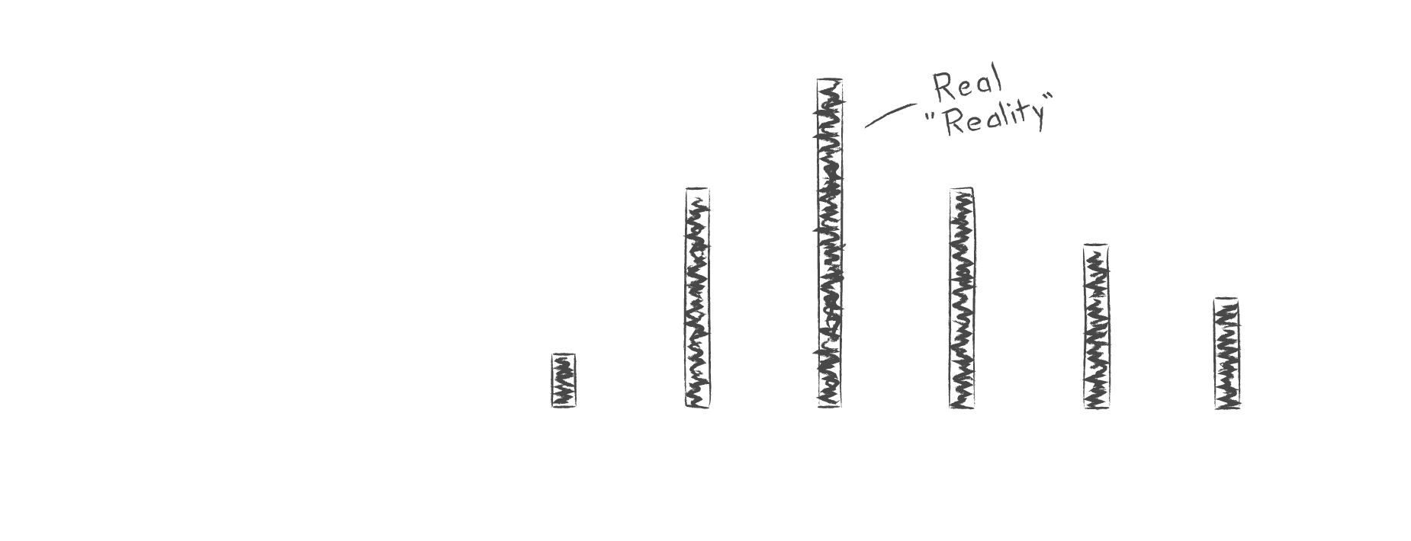

Recovery expectations versus reality
Source: Enterprise Strategy Group, 2016. Crayon scribbles are outright guesses by the presenter.
Notes:
Next, participants were asked to report the actual recovery times that they could support. Now look at this contrast. While 52% could tolerate less than an hour of downtime, only 24% could meet that requirement. <CLICK> And the vast majority of workloads could support RTOs no better than two hours or more. This sharp contrast illustrates the divide between what the business requires, and what IT can actually deliver.

Slide 6




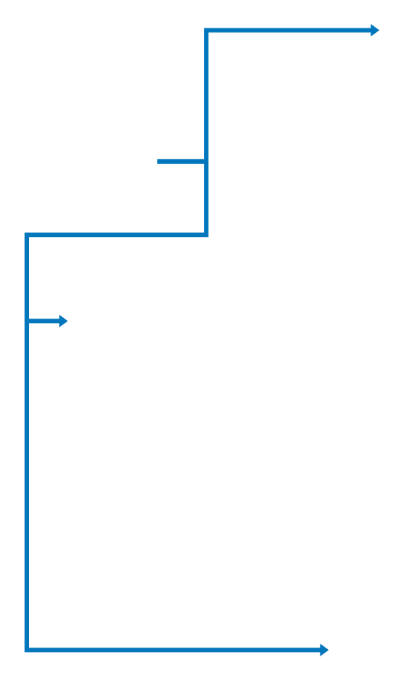
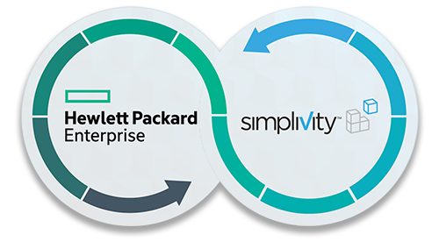
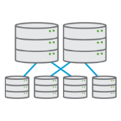


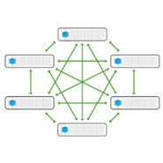

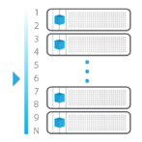
Policy-Based VM-Centric Management
Abstracted from Underlying
Locations & Devices
Predictable Performance
Peak Performance
VM
Global Efficient
VM & Data Mobility
Global, Inline Deduplication
& Compression,
Once & Forever
Resiliency (Local HA)
Enterprise
Protection &
Resiliency
Scale – Multiple Sites
Global Management and Protection Policies
Built-In Data Protection
Automated,
Granular RTO / RPO
with Near-Zero Overhead
Scale - Single Site
Notes:
Globally synchronized management of all VMs across sites rather than point-to-point IP address management (DK)

Slide 7


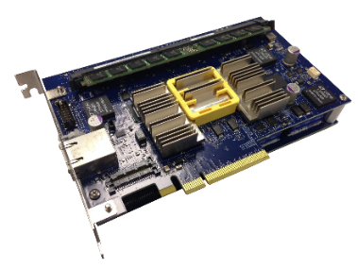
HPE SimpliVity Data Virtualization Platform
VMs
Data Virtualization Platform
Presentation layer
All data written/registered to virtualization platform
Data Management layer
Persistent storage
Only unique data written to disk
“The best IO is the one you don’t have to do.”
Notes:
Script:
Let’s take a deeper look at how this works.
Click x2
First, if we take off the bezel and open it up, you’ll see it’s a standard x86 server with standard components like HDD, SSD, DRAM, and x86 CPU and memory. And, just like any other host, we’re running ESXi.
Click
Then we bring in the DVP, which sits architecturally between the hardware and the hypervisor, abstracting the hardware from the VMs / apps that are running on top.
Click x2
Within that layer sits the accelerator card, the PCIe card that deduplicates, compresses, and optimizes all data inline at inception once and forever, like we’ve already discussed.
When we peel back the onion a bit, you’ll see that the DVP actually has two layers: 1. the presentation layer, which is what VMware will logically interact with; and 2. the management layer, where the metadata is stored and managed.
Click
Let’s take a look at the write path. The first thing that happens is a new write will come in.
Click
VMware will write it and
Click
we’ll register the metadata. What actually happens first is that it will really write it to the card. Then the card will synchronously mirror to another card in another node for high availability. When both cards have the data, they’ll persist it and acknowledge back to the host. Each card has 8 GB of cache and NVRAM and supercapacitors. In case the power fails, the card will flush to NVRAM to protect the data.
Click
Then we’ll analyze the data. If it’s unique, as this block is at 8 KB, then we’ll write it to HDD in compressed form.
Click
Another write comes in.
Click
It’s unique, we’ll compress it and write it to disk.
Click
Another write that’s green this time.
Click
It’s unique, we’ll compress it and write it to disk.
Click
Now, let’s see what happens when a duplicate block—which is most blocks—comes in. We know that the fastest I/O is the one you never have to write, and therefore by eliminating I/O, you’ll increase performance. So let’s see what that looks like.
Click
When that duplicate block comes in, VMware thinks it wrote unique data. However, the DVP recognizes that that block already exists somewhere within the shared resource pool. It updates the metadata, and that’s it. No data was written! No new I/O.
Click
And another duplicate block comes in.
Click
And the same—no new data written.

Slide 8
HPE SimpliVity Data Virtualization Platform
VMs
Data Virtualization Platform
Presentation layer
Data Management layer
Persistent storage
“The best IO is the one you don’t have to do.”
Notes:
Script:
Let’s take a deeper look at how this works.
Click x2
First, if we take off the bezel and open it up, you’ll see it’s a standard x86 server with standard components like HDD, SSD, DRAM, and x86 CPU and memory. And, just like any other host, we’re running ESXi.
Click
Then we bring in the DVP, which sits architecturally between the hardware and the hypervisor, abstracting the hardware from the VMs / apps that are running on top.
Click x2
Within that layer sits the accelerator card, the PCIe card that deduplicates, compresses, and optimizes all data inline at inception once and forever, like we’ve already discussed.
When we peel back the onion a bit, you’ll see that the DVP actually has two layers: 1. the presentation layer, which is what VMware will logically interact with; and 2. the management layer, where the metadata is stored and managed.
Click
Let’s take a look at the write path. The first thing that happens is a new write will come in.
Click
VMware will write it and
Click
we’ll register the metadata. What actually happens first is that it will really write it to the card. Then the card will synchronously mirror to another card in another node for high availability. When both cards have the data, they’ll persist it and acknowledge back to the host. Each card has 8 GB of cache and NVRAM and supercapacitors. In case the power fails, the card will flush to NVRAM to protect the data.
Click
Then we’ll analyze the data. If it’s unique, as this block is at 8 KB, then we’ll write it to HDD in compressed form.
Click
Another write comes in.
Click
It’s unique, we’ll compress it and write it to disk.
Click
Another write that’s green this time.
Click
It’s unique, we’ll compress it and write it to disk.
Click
Now, let’s see what happens when a duplicate block—which is most blocks—comes in. We know that the fastest I/O is the one you never have to write, and therefore by eliminating I/O, you’ll increase performance. So let’s see what that looks like.
Click
When that duplicate block comes in, VMware thinks it wrote unique data. However, the DVP recognizes that that block already exists somewhere within the shared resource pool. It updates the metadata, and that’s it. No data was written! No new I/O.
Click
And another duplicate block comes in.
Click
And the same—no new data written.

Slide 9
HPE SimpliVity Data Virtualization Platform
VMs
Data Virtualization Platform
Presentation layer
Data Management layer
Persistent storage
“The best IO is the one you don’t have to do.”
Notes:
Script:
Let’s take a deeper look at how this works.
Click x2
First, if we take off the bezel and open it up, you’ll see it’s a standard x86 server with standard components like HDD, SSD, DRAM, and x86 CPU and memory. And, just like any other host, we’re running ESXi.
Click
Then we bring in the DVP, which sits architecturally between the hardware and the hypervisor, abstracting the hardware from the VMs / apps that are running on top.
Click x2
Within that layer sits the accelerator card, the PCIe card that deduplicates, compresses, and optimizes all data inline at inception once and forever, like we’ve already discussed.
When we peel back the onion a bit, you’ll see that the DVP actually has two layers: 1. the presentation layer, which is what VMware will logically interact with; and 2. the management layer, where the metadata is stored and managed.
Click
Let’s take a look at the write path. The first thing that happens is a new write will come in.
Click
VMware will write it and
Click
we’ll register the metadata. What actually happens first is that it will really write it to the card. Then the card will synchronously mirror to another card in another node for high availability. When both cards have the data, they’ll persist it and acknowledge back to the host. Each card has 8 GB of cache and NVRAM and supercapacitors. In case the power fails, the card will flush to NVRAM to protect the data.
Click
Then we’ll analyze the data. If it’s unique, as this block is at 8 KB, then we’ll write it to HDD in compressed form.
Click
Another write comes in.
Click
It’s unique, we’ll compress it and write it to disk.
Click
Another write that’s green this time.
Click
It’s unique, we’ll compress it and write it to disk.
Click
Now, let’s see what happens when a duplicate block—which is most blocks—comes in. We know that the fastest I/O is the one you never have to write, and therefore by eliminating I/O, you’ll increase performance. So let’s see what that looks like.
Click
When that duplicate block comes in, VMware thinks it wrote unique data. However, the DVP recognizes that that block already exists somewhere within the shared resource pool. It updates the metadata, and that’s it. No data was written! No new I/O.
Click
And another duplicate block comes in.
Click
And the same—no new data written.

Slide 10







Highly resilient architecture
Object
VM
Node
Cluster
Federation
VM
File- and object-level restore
App-aware backups
Multiple points in time
Restore to any VM
New or replacement VM
Multiple points in time
Fully independent
Hardware RAID
Component-level redundancy & protection
Integrity checks & bit rot detection
Per-VM RAIN
High availability
Site-to-site disaster recovery
Remote backup & recovery
Unique block replication
* For detailed information about the HPE SimpliVity Guarantee, including conditions and limitations please see HPE SimpliVity Guarantee
Notes:
<CLICK>Lastly, SimpliVity’s highly resilient architecture helps to minimize downtime and prevent data loss. Our in-depth approach includes object and file-level restores, VM-level protection, hardware redundancy, high availability at the data center level, and site-to-site disaster recovery within the SimpliVity Federation.
Now let’s what the impact of SimpliVity’s built-in data protection has been for our customers.

Slide 11




Simple and highly efficient offsite disaster recovery
Boston
Tokyo
WAN-efficient remote backups
Global VM-centric management
Rapid recovery at DR site
Choice of HPE SimpliVity cloud service providers for DRaaS
VM
VM
VM
VM
VM
VM
VM
VM
VM
VM
VM
VM
VM
VM
VM
VM
Boston
Tokyo
Notes:
<CLICK>As part of SimpliVity’s built-in data protection capabilities, we offer simple and highly efficient offsite disaster recovery. <CLICK>Globally aware deduplication enables WAN-efficient remote backups for seamless mobility of VM data between sites. <CLICK>VM-centric backup policies make it easy to configure and manage remote backups, while rapid restores help to resume IT services quickly in case of an outage. <CLICK> And for organizations that wish to outsource their disaster recovery plans, we can help customers partner with a SimpliVity cloud service provider that delivers DR as a service.

Slide 12



Rapid recovery. Push-button simplicity.
Boston
Tokyo
Automated disaster recovery
Power VMs at recovery site
Configure IP and settings
Run pre and post scripts
One-click activation
Automated recovery workflow
Single-vendor solution
    One support call
    9.5/10 customer satisfaction¹
VM
HPE SimpliVity RapidDR
VM
VM
VM
VM
VM
VM
VM
VM
START
VM
VM
Activate recovery
Power on VMs
Configure resources
Configure network
VM
VM
VM
VM
VM
Boston
Tokyo
For detailed information about the HPE SimpliVity Guarantee, including conditions and limitations please see HPE SimpliVity Guarantee
Source: Omega Management Group Corp, NorthFace ScoreBoard Award for Excellence in Customer Service and Support, Aug 2016
Notes:
RapidDR – a disaster recovery automation solution that provides rapid recovery of virtualized workloads, with push-button simplicity.
RapidDR works with SimpliVity hyperconverged infrastructure deployments and automates site-to-site failover in case of an outage, including which VMs to recover, in what sequence they should be powered on, resource settings, network settings, and more.
An intuitive interface walks users through a step-by-step planning guide that helps them build their recovery workflows.
All of this is delivered in a single vendor solution, all delivered by SimpliVity, with one number to call and SimpliVity’s award-winning customer support organization available to help our customers whenever they need it.

Slide 13
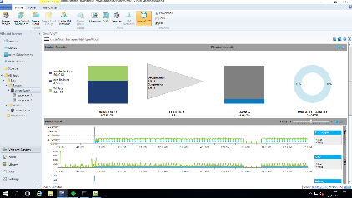



VM-centric management
Alignment of data to VMs managed through Microsoft SCVMM
Over half (57%) of customers
benefitted from an average of
53%
increase in staff productivity
Just a few clicks to…
Simple, intuitive interface
No LUNs, shares, or volumes
Empowers IT generalists and VM admins
Familiar tools and interfaces like Microsoft SCVMM
Notes:
One of the primary advantages of HPE SimpliVity hyperconvergence is the simplification of management. All underlying data services have been abstracted for the user, so that it takes just a few clicks provision workloads, create data stores, backup, clone, move, or restore a VM.
There is no longer a need to focus on low-level components like LUNs, shares, or volumes. This means you can empower virtualization admins and IT generalists, and reduce your dependence on specialists. And the best thing is that all of this comes in a familiar management interface such as vCenter or vRealize automation —there is no new management console or interface to worry about with HPE SimpliVity.
The net effect of all these benefits is greater time savings for IT teams. In fact, the Forrester TEI Study found that adopting organizations saved about 25 hours per week managing backups, and realized 50% reduction in hours/first year in consulting hours, reducing or eliminating their reliance on outside specialists.

Slide 14

Start small and scale out – from pilot to production
Start at two nodes
Fast and simple deployment
Linear scale to match demand
1 hour
To deploy an 8-node cluster
Initial pilot
Production rollout
Expanded rollout

Slide 15



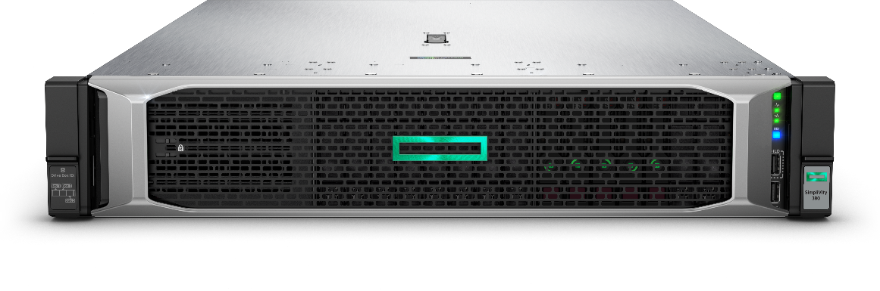
Built on HPE ProLiant DL380
The industry’s most trusted foundation
"Future proof" design keeps up with your business needs
Industry-leading energy efficiency for quicker returns on your investment
Agile infrastructure management for accelerating IT service delivery
Data center standard for multi-workload compute
Powered by Intel Xeon E5-2600 v3/v4 series processors (Gen9) and Intel Xeon Scalable Processor Family (Gen10)
Delivers best performance and expandability in the
HPE 2P rack portfolio
Reliability, serviceability, and availability, backed by comprehensive warranty
Ideal for any environment
All-flash extra-small, small, medium, and large configurations
Notes:
HPE SimpliVity 380 is built on the world’s best-selling server—the HPE ProLiant DL380. (Source: HPE ProLiant DL380 Server is the world’s best-selling server, according to the CQ1’16 IDC Server Tracker.)
//Refer to slide points//

Slide 16
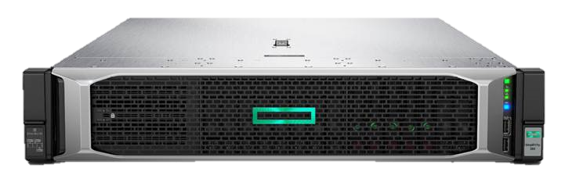
HPE SimpliVity 380 Gen 10 Models
HPE SimpliVity 380 Gen 10 “All Flash” Model Specifications
Model | CPU Configuration | Memory | Storage Configuration | Effective Storage Capacity | RAID Configuration
XS | 1P Intel Xeon 8-14, 16-22 Cores | 87 – 711 GB | 5 x 960GB SSD | 3 – 6 TB | RAID 5
 | 2P Intel Xeon 8-14, 16-22 Cores | 156 – 1436 GB
Small | 1P Intel Xeon 8-14, 16-22 Cores | 87 – 711 GB | 5 x 1.92TB SSD | 6 – 12 TB | RAID 5
 | 2P Intel Xeon 8-14, 16-22 Cores | 156 – 1436 GB
Medium | 1P Intel Xeon 8-14, 16-22 Cores | 87 – 711 GB | 9 x 1.92TB SSD | 12 – 25 TB | RAID 6
 | 2P Intel Xeon 8-14, 16-22 Cores | 156 – 1436 GB
Large | 1P Intel Xeon 8-14, 16-22 Cores | 87 – 711 GB | 12 x 1.92TB SSD | 20 – 40 TB | RAID 6
 | 2P Intel Xeon 8-14, 16-22 Cores | 156 – 1436 GB
Extra Large | 1P Intel Xeon 8-14, 16-22 Cores | 87 – 711 GB | 12 x 3.84TB SSD | 40 – 80 TB | RAID 6
 | 2P Intel Xeon 8-14, 16-22 Cores | 156 – 1436 GB
16

Slide 17

HyperEfficient: save 90% capacity across storage and backup combined
HyperProtected: under 1 minute to complete a local backup or local restore of a 1 TB VM
HyperSimple: 3 clicks to back up, restore, move, or clone a VM from a single console
HyperManageable: under 1 minute to create or update backup policies for 1000s of VMs across dozens of sites
HyperAvailable: add or replace HPE SimpliVity systems with zero downtime for local or remote sites
  Zero disruption to local or remote SimpliVity backups
  Zero reconfiguration of SimpliVity backup policies for local or remote sites
  Zero re-entry of IP addresses in remote sites
* HPE SimpliVity HyperGuarantee applies to current HPE SimpliVity and HPE OmniStack products and the new HPE SimpliVity 380 product.
Notes:
Did I mention we guarantee a lot of the results we talked about today?
//Refer to slide points//

Slide 18

Thank you

